Slide 1

MyTaxiService Design Document Software Engineering 2, 2015/2016
Nenad Petrović

Slide 2
High level architecture

Slide 3
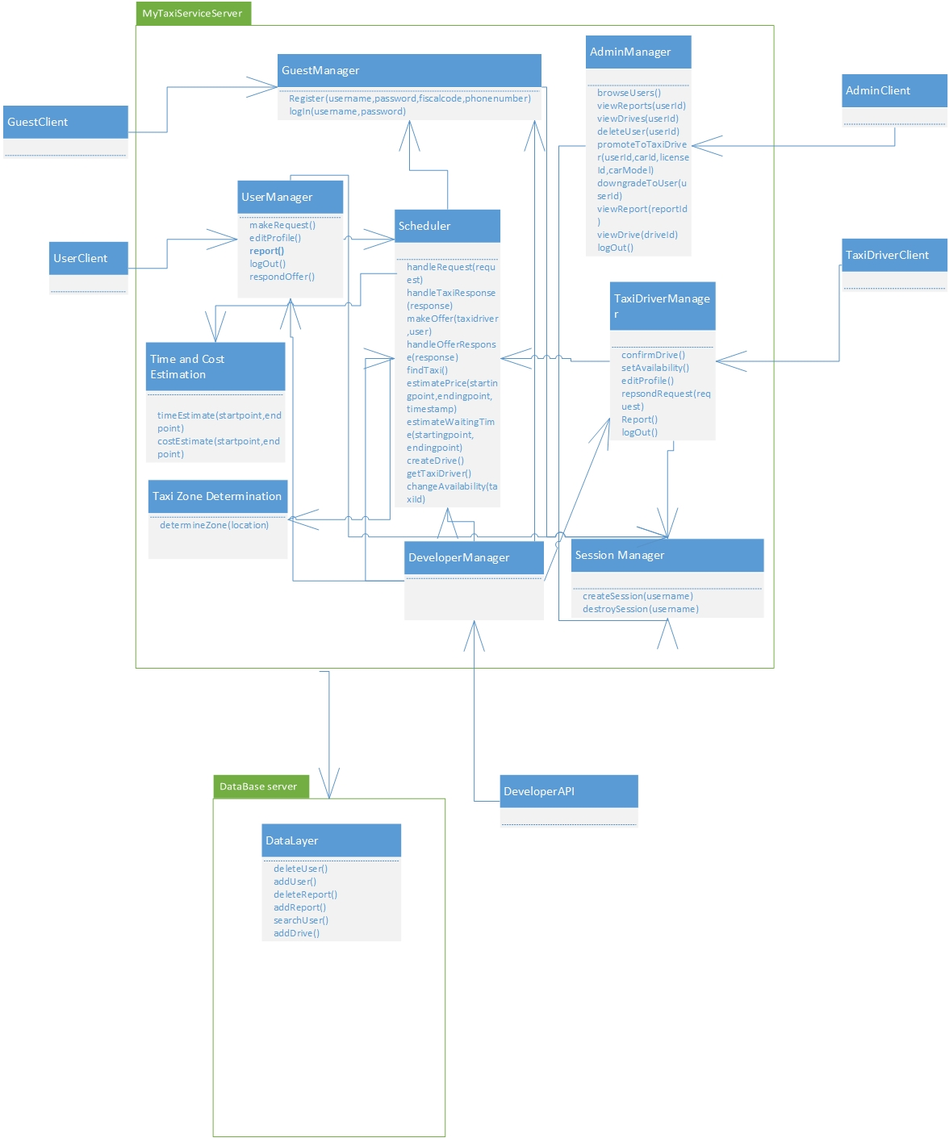

Slide 4
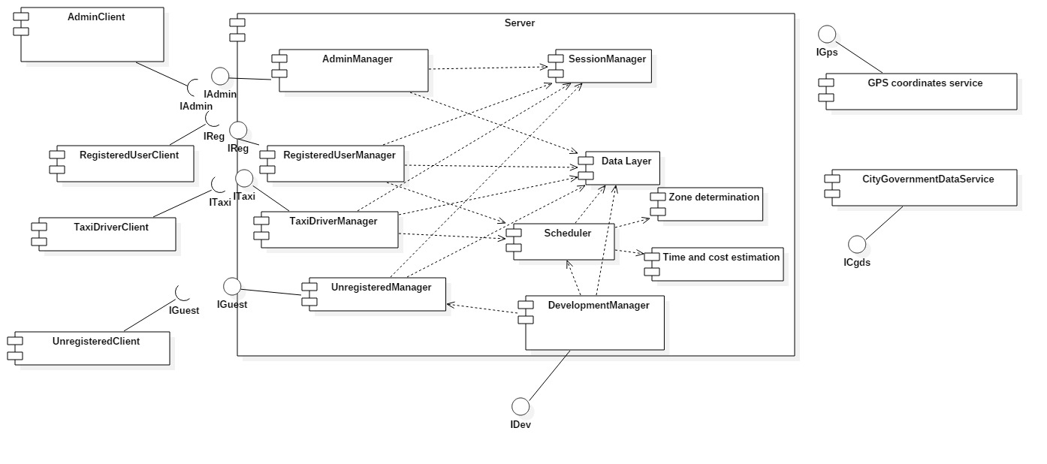
Component view

Slide 5
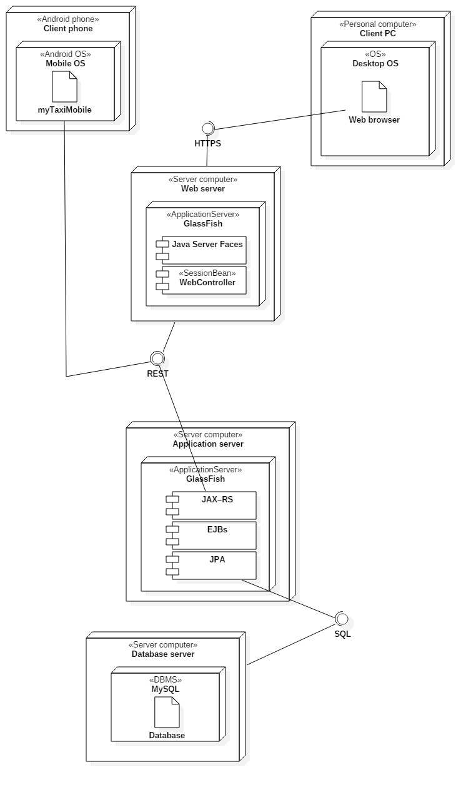
Deployment view

Slide 6
Runtime view

Slide 7
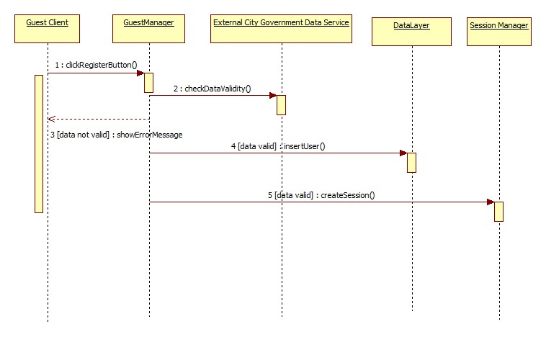
Register user

Slide 8
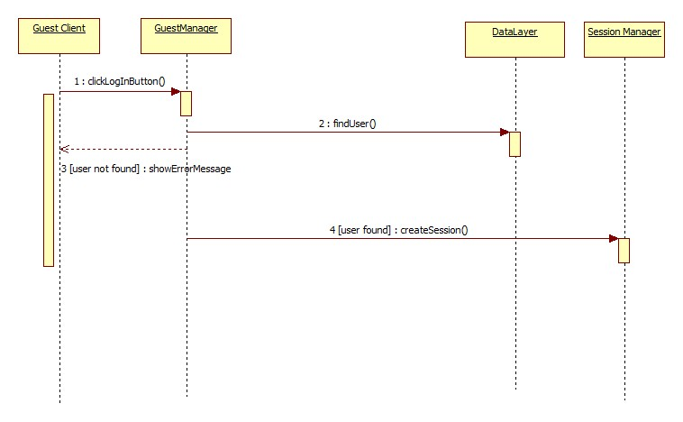
Log in

Slide 9
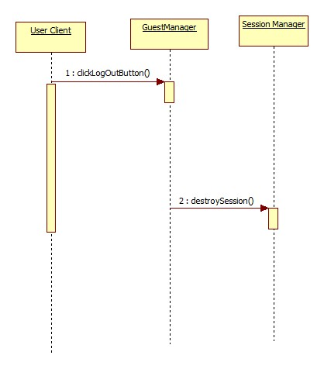
Log out

Slide 10
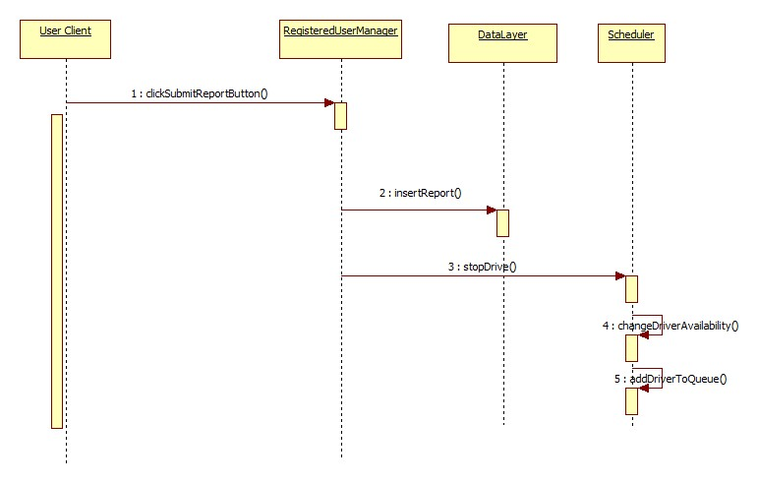
Report user

Slide 11
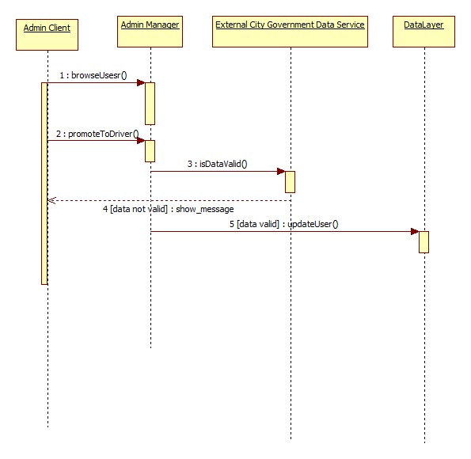
Promote to taxi driver

Slide 12
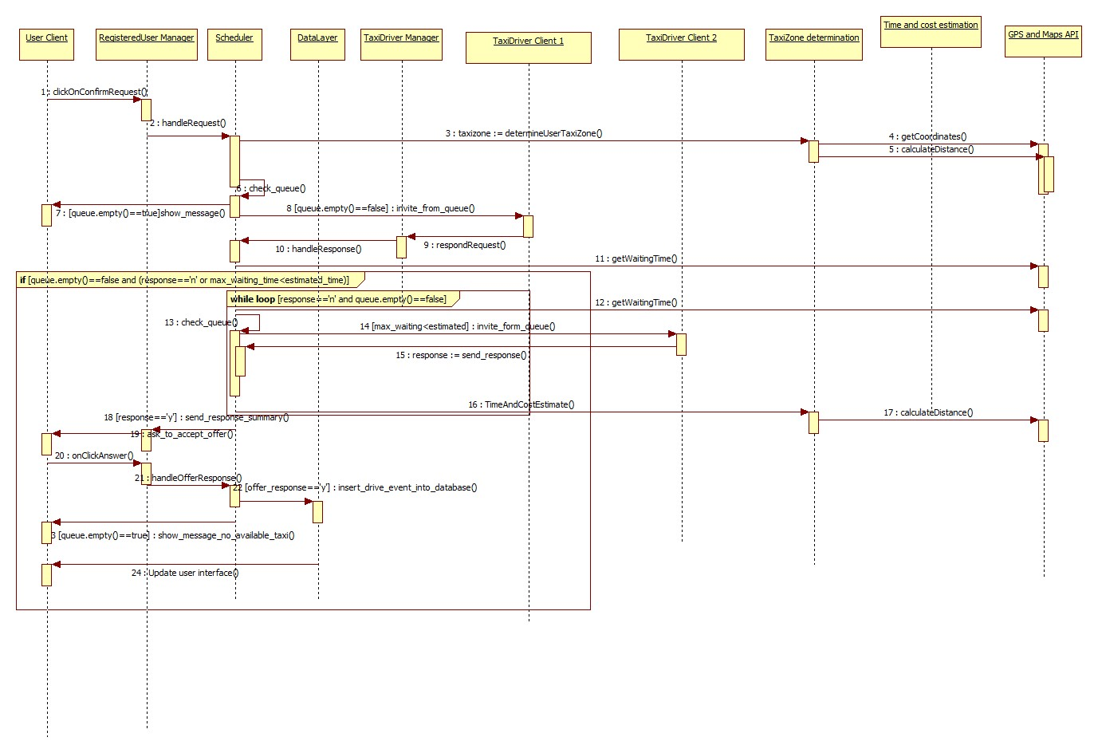
Request taxi

Slide 13
Component interfaces

Slide 14
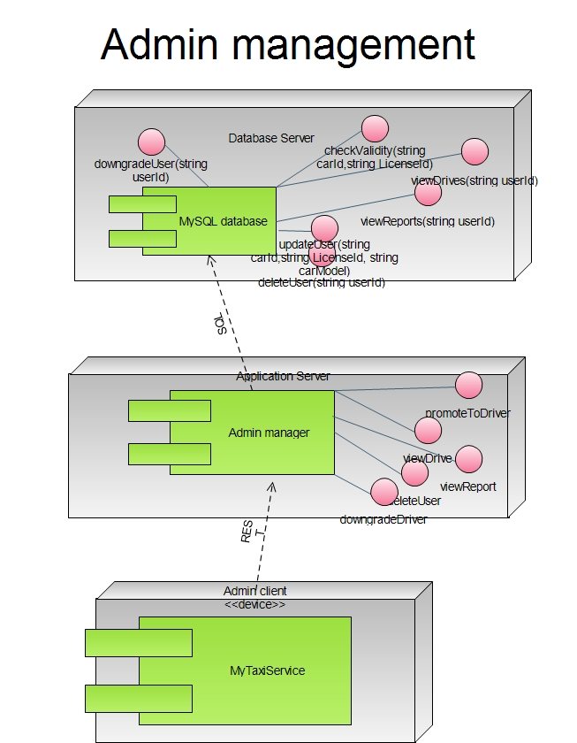

Slide 15
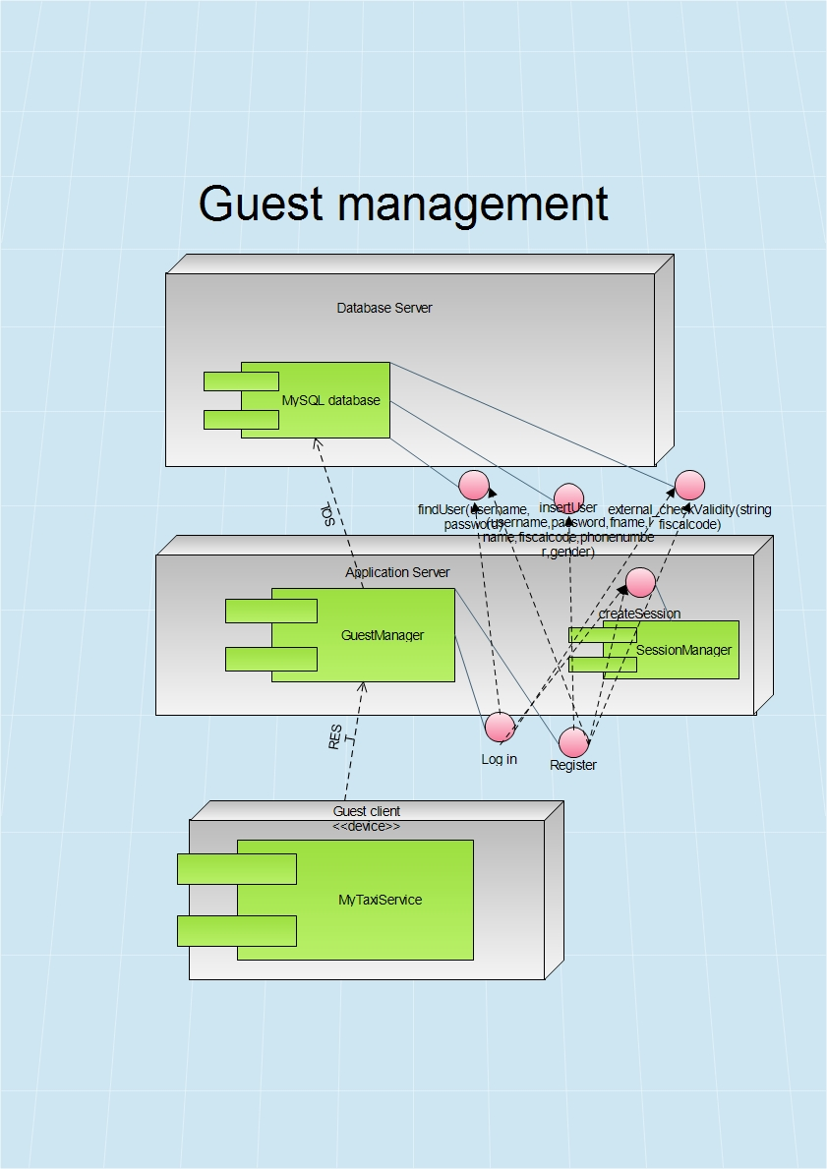

Slide 16
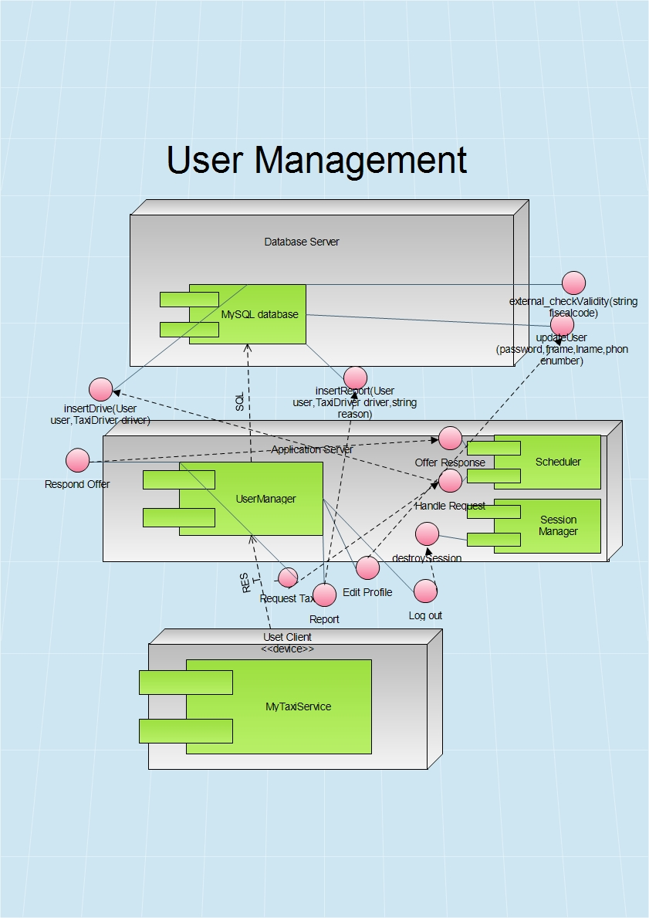

Slide 17
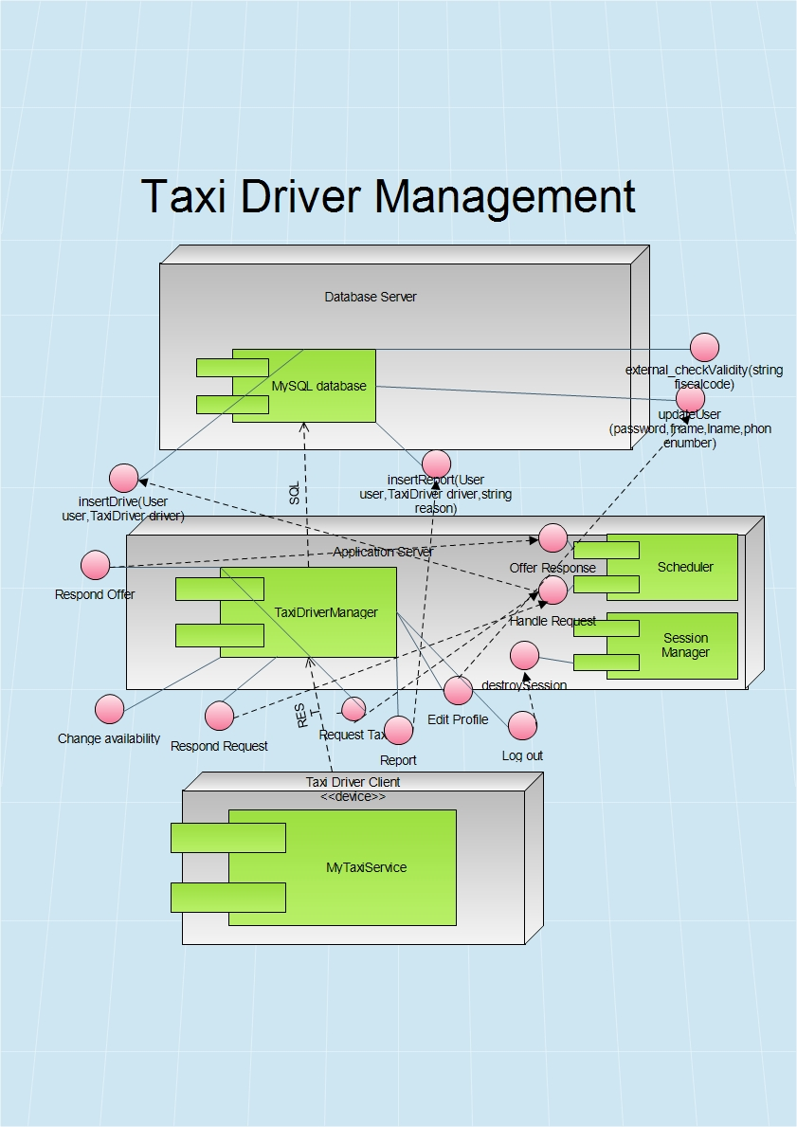

Slide 18
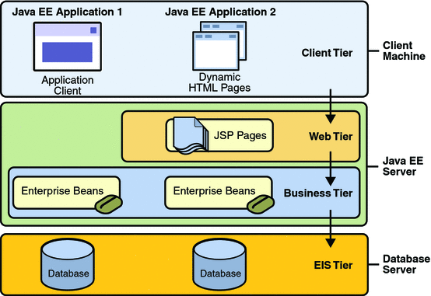
Java EE multitier

Slide 19
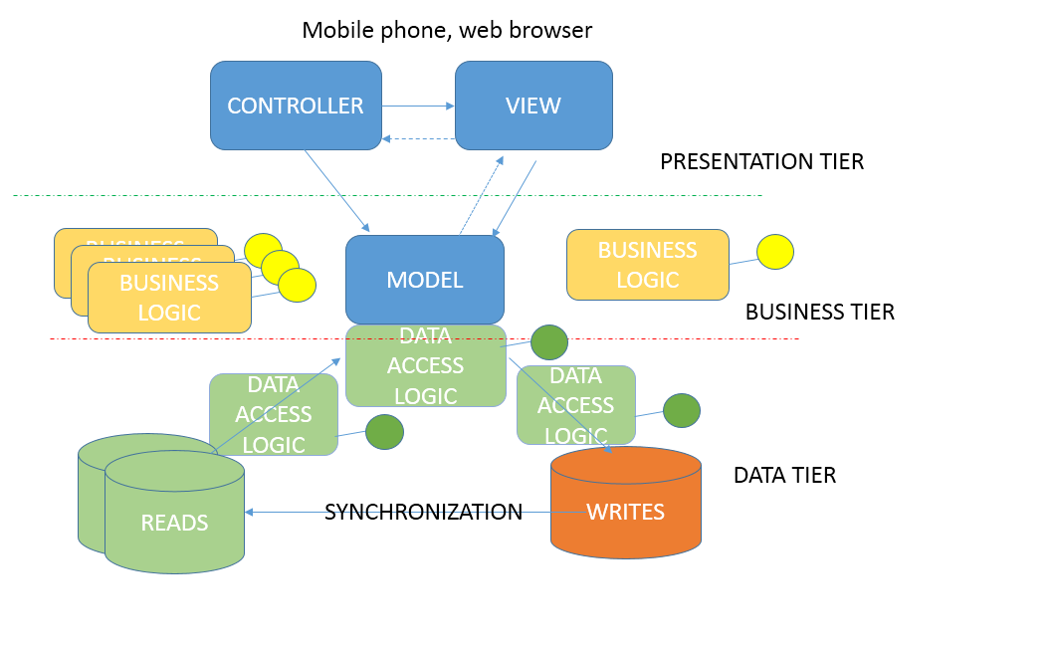
MVC variant

Slide 20
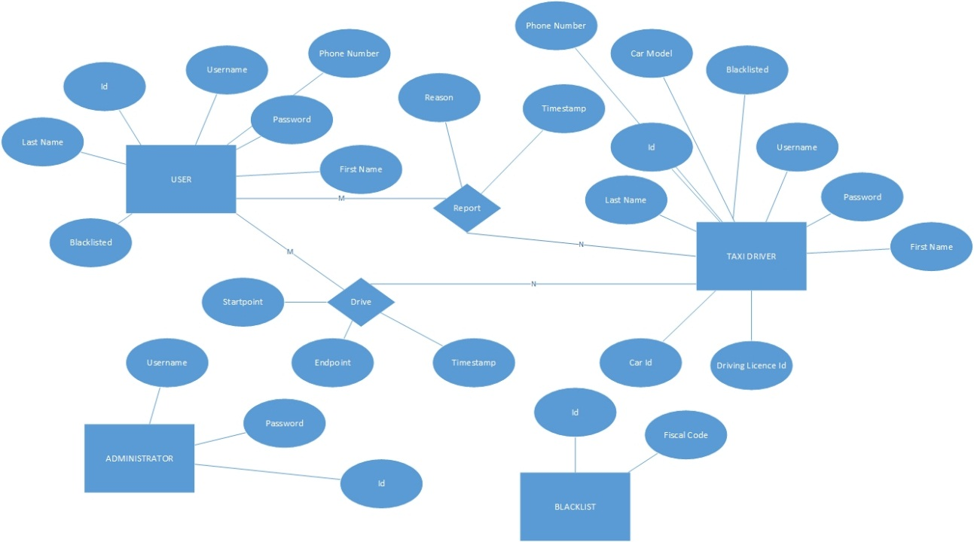
Database

Slide 21
Requirements traceability
Registration/Taxi driver promotion data check – External database
GPS coordinates determination and calculation – External GPS/Maps API
Blacklist – db storage
Reports – db storage
Maintainability – flexible cost estimation algorithm
API for developers

